Slide 1

Money Transfer Application
Task - 1

Slide 2
Money Transfer Application
This application will provide an intuitive and user-friendly interface for customers to send and receive funds domestically or internationally.
LMS Username | Name | Batch
2113a4921 | Aswin S | A49

Slide 3
Table of Contents
Introduction
Objective
Purpose
Scope
Glossary
Overall Description
Product Perspective
Hardware Requirements
Software Requirements
Functional Requirements
Non-Functional Requirements
Diagrammatic Representations
Use Case Diagram
Class Diagram
Data Flow Diagram
Sequence Diagram

Slide 4
Step-Wise Description
Introduction: The Money Transfer Application is a software system designed to facilitate fast, secure and reliable transfer of money between bank accounts. The system will provide an intuitive and user-friendly interface for customers to send and receive funds domestically or internationally. Purpose: The purpose of this document is to provide a detailed description of the requirements for the Money Transfer Application, including functional and non-functional requirements, constraints, and interfaces. Scope: The Money Transfer Application will be a web-based application accessible through a desktop or mobile device. The system will allow customers to transfer funds between their own accounts or to other accounts within the same bank or to accounts in other banks. Glossary: React -> JavaScript library Json -> JavaScript Object Notation DFD -> Data Flow Diagram FD -> Context Flow Diagram ER -> Entity Relationship IDE -> Integrated Development Environment SRS -> Software Requirement Specification

Slide 5
Product Perspective: The money transfer application is designed with the user's needs in mind. This includes features that make it easy for users to send and receive money, as well as tools for managing their accounts, tracking transactions, and accessing customer support. The user interface is intuitive and easy to navigate, with clear instructions and feedback to guide users through each step of the process. It is also be designed with accessibility in mind, so that users of all abilities can use the app comfortably. Hardware Requirements: Processor: Intel i5 Windows: 7/8/8.1/10 Software Requirements: Visual Studio: 2GB RAM ,1.2 GHz Front-end: React JS Back-end: Json

Slide 6
Functional Requirements 1. User registration and login: The app should allow users to create an account, enter their personal information, and securely log in to the app. 2. Send and receive money: The app should allow users to send and receive money, either to other users of the app or to external bank accounts or payment systems. 3. Currency conversion: The app should support multiple currencies and provide currency conversion capabilities for transactions that involve different currencies. 4. Payment options: The app should allow users to fund their accounts and make payments using a variety of payment options, such as bank transfers, credit cards, or digital wallets. 5. Transaction tracking: The app should provide users with a transaction history and allow them to track the status of their transactions in real-time. 6. Customer support: The app should provide users with access to customer support, either through chat, phone, or email. 7. Security features: The app should include security features such as two-factor authentication, encryption of user data, and fraud detection and prevention. 8. Compliance with regulations: The app should comply with relevant financial regulations, such as anti-money laundering (AML) and know your customer (KYC) requirements. 9. Integration with external systems: The app should be able to integrate with external systems, such as banking systems, payment gateways, and social media platforms, to facilitate transactions and improve the user experience. 10. Notifications and alerts: The app should provide users with notifications and alerts for important events, such as successful transactions or failed transactions.

Slide 7
Non-Functional Requirements 1. Performance: The app should be designed to perform well and handle high volumes of transactions without lagging or crashing. It should also be designed to handle network latency and poor network conditions. 2. Scalability: The app should be designed to handle a growing user base and increased transaction volumes. It should be able to scale horizontally and vertically as needed. 3. Availability: The app should be available to users 24/7, with minimal downtime for maintenance or upgrades. 4. Reliability: The app should be designed to be reliable, with backup and recovery systems in place to ensure that user data and transaction histories are not lost in case of system failure. 5. Usability: The app should be designed to be easy to use and navigate, with a user-friendly interface and clear instructions for each step of the transaction process. 6. Security: The app should be designed with strong security measures, such as encryption of user data, two-factor authentication, and fraud detection and prevention. 7. Compliance: The app should comply with relevant financial regulations and industry standards, such as PCI DSS and GDPR. 8. Compatibility: The app should be designed to work on a range of devices and operating systems, and should be compatible with popular web browsers and mobile devices. 9. Maintainability: The app should be designed to be easily maintainable and upgradable, with a modular architecture and clean codebase. 10. Performance monitoring: The app should be designed to monitor performance and usage metrics, with tools for identifying and resolving performance bottlenecks and other issues.

Slide 8
Constraints Security constraints: The application must comply with various security standards and regulations to ensure the protection of user data and financial information. Regulatory constraints: The application must comply with various financial regulations, such as anti-money laundering (AML) and know-your-customer (KYC) requirements. Technical constraints: The application must be designed to work with a variety of technical infrastructures and devices, such as desktop computers, mobile devices, and different operating systems. Time constraints: The application must be developed and deployed within a specific timeline to meet the business requirements and market demands. Cost constraints: The development and maintenance of the application must be within the allocated budget. User constraints: The application must be designed to meet the needs of the intended users, including their preferred payment methods, currencies, and languages. Performance constraints: The application must be designed to perform efficiently and handle high volumes of transactions without compromising the user experience. Availability constraints: The application must be available to users 24/7, with minimal downtime for maintenance or upgrades. Integration constraints: The application must be designed to integrate with external systems such as banking systems, payment gateways, and social media platforms, to facilitate transactions and improve the user experience. Testing constraints: The application must be tested thoroughly before deployment to ensure that it meets the functional, non-functional, and security requirements.

Slide 9
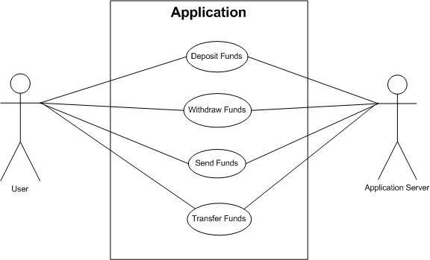
Use Case Diagram

Slide 10
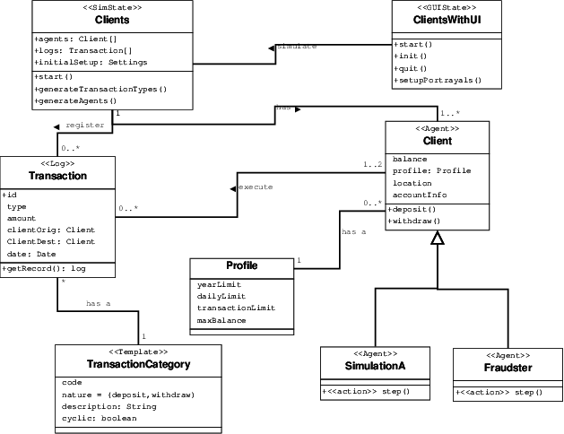
Class Diagram

Slide 11
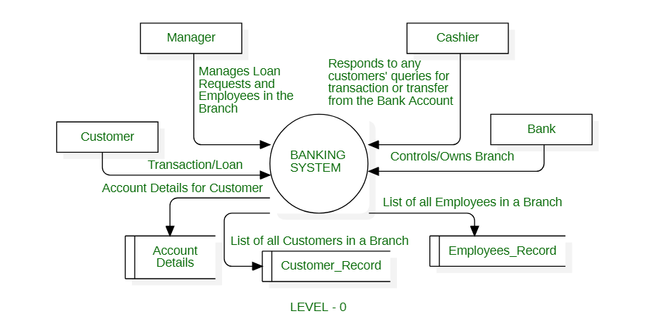
Data Flow Diagram

Slide 12
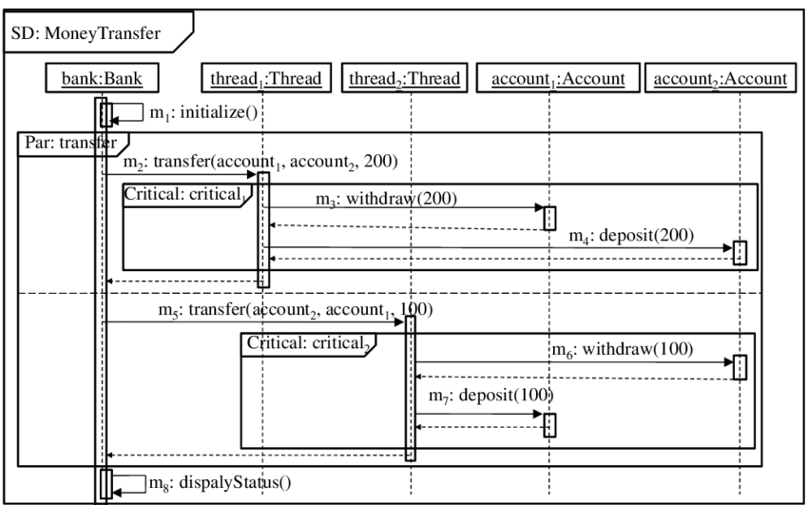
Sequence Diagram

Slide 13
Submission Github
https://https://github.com/Aswin-007/NM-Full-Stack

